Slide 1
About This Presentation
FY19 Oracle Blockchain Intro
Created By: Autonomous PaaS Product Marketing
Target Audience: External Audience
Objective: To explain the Oracle Blockchain Story to customers
How to use this deck: This is a customer pitch deck
PLEASE DO NOT MODIFY THESE SLIDES, DECOMPOSE, or ALTER MESSAGES or GRAPHICS
Authors: Jay Chugh, Nassir Khan
Contributors: Ashish Mohindroo. Key stakeholders from: Product Marketing: All Pillars, Development, Corporate Marketing, Global Field Sales, Regional Executive Leadership from each and many others.
Feedback: Please send questions/comments to the authors
Date Updated: June 27, 2018

Slide 3


Oracle Blockchain
Customer Presentation
Name
Title
Copyright © 2018, Oracle and/or its affiliates. All rights reserved.
3
Notes:
Welcome. Thank you for joining me today.
Hi I’m Ashish Mohindroo.
I would like to walk you through our Oracle Cloud Platform and how we uniquely provide paths to cloud to best meet the needs of all businesses.

Slide 4
Business Challenges
Difficulty to establish Trust without intermediaries in business partnerships
Lack of Transparency in multi-party transactions
Transaction overhead due to dependence on 3rd parties / intermediaries
Dependence on Manual, error-prone processes
Why Trust
Why Transparency
Why Reduce 3rd Party Overhead
Why Eliminate Manual Processes
To ensure systems of records are reliable & tamper-proof
To ensure participants act in good faith in B2B transactions
To ensure all business parties have real time access to a single source of truth
To avoid fraud or errors due to multiple redundant sources of truth
To avoid unnecessary delays
To eliminate transaction fees, which eats into profit
To reduce risk of human errors due to redundant manual reconciliations
To reduce cost and complexity of manual labor and paperwork
Notes:
Let’s go a little deeper as to what are the new challenges but also opportunities that we should be discussing.
Trust
Transparency
Dependence on centralized intermediaries
Manual, Error-prone processes
Technology to realize this is available in abundance, and the early adopters who apply those stand to gain massive rewards.
That said, innovation and democratized access to game changing technologies driven by cloud, can prove as “truly leveling the playing field”.
I tried to pick from every industry some of those examples, some very well-known and “uber”-used for this purpose, but the point is, that every industry sees its fair share of new entrants and new business models. Ownership to access being a strong driver. Mobility when you need it. Personalized music and video streaming, crushing previous empires.
Want to highlight just one of those here to make the point. Even industries which I personally did not consider prime candidates for disruption, are being heavily disrupted right now. Take insurance. The little device on the lower right hand side here can be plugged into your car, and with that – instantly your driving behavior, your actual usage of your car becomes accessible to your insurance company. We can track if your car sits in the drive way, not being moved – so why pay insurance? Usage based billing, safe driving discounts (e.g. How fast are you approaching a stop sign) are now all available. IoT data can help drive very different business models and customer experiences.

Slide 5
BLOCKCHAIN
Blockchain is an incorruptible, distributed ledger that enables trusted & transparent business transactions with single source of truth among parties who may not fully trust each other, without overhead of intermediaries
Essentially, Blockchain provides trust as a service at a lower cost
Notes:
Corporation have to deal with many systems of records which sometimes span multiple organizational boundaries Discrepancies in these systems occurs resulting in transaction latency, increased operational expense and decreased efficiencies. Blockchain enables corporations to enforce a decentralized, single source of truth resulting in greater transparency, thus reducing cost of enabling trust among businesses.
Encompasses both a distributed ledger and smart contract
Distributed ledger - An append-only system of record or log of transactions
Smart contract – Software equivalent of regular contracts that executes autonomously on each blockchain node according to pre-determined business rules

Slide 6
Characteristics of Blockchain
Tamper-proof data
Records written to the blockchain cannot easily be changed or deleted
Enhances trust in decentralized single source of truth
Shared & Transparent
Distributed ledger enables single shared source of truth distributed across all nodes
Enables transparency, reduced delays & cost of 3rd party intermediaries
Consensus Based
Updates to distributed ledger are made after consensus among network peers
Protects against fraud among participants, and maintains trust in the ledger
Security & Privacy
Only those authorized with keys can view the data
Blockchain stores auditable historic records that can be encrypted for privacy
Enables Trust
Notes:
So what about blockchain makes it so interesting?
It starts with tamper-proof, non-refutable records. Everyone maintains an encrypted record of every transaction. To go back and change a transaction would require simultaneously taking over the entire network for an extended period of time. And that is as close to impossible as things get.
Because it's decentralized, there's no one location where everything is stored. That means better security -- and -- availability. There's no central point of vulnerability.
Finally, there's a useful industry standard that just about everyone is using -- it's called the Hyperledger Fabric, and it's being developed and promoted by the Linux Foundation. That means blockchain networks and applications can interoperate.

Slide 7
Two Types of Blockchain
PERMISSIONED
PERMISSIONLESS (or Public)
Members in business network are invited to join network
Examples: manufacturer & its suppliers, cargo shipper and its broker network, etc.
More secure & better governance - parties are known in advance
Better suited for the enterprise
Anyone on Internet may join and have access to the ledger information
Examples: Bitcoin, Ethereum, etc.
Less secure & poorer governance - parties not known in advance
Oracle Offers a Permissioned Enterprise Blockchain Platform
Notes:
Corporation have to deal with many systems of records which sometimes span multiple organizational boundaries Discrepancies in these systems occurs resulting in transaction latency, increased operational expense and decreased efficiencies. Blockchain enables corporations to enforce a decentralized, single source of truth resulting in greater transparency, thus reducing cost of enabling trust among businesses.
Encompasses both a distributed ledger and smart contract
Distributed ledger - An append-only system of record or log of transactions
Smart contract – Software equivalent of regular contracts that executes autonomously on each blockchain node according to pre-determined business rules

Slide 8
ENTERPRISE BLOCKCHAIN IN ACTION

Slide 9
Blockchain for Trade Finance
CURRENT APPROACH
BLOCKCHAIN APPROACH
1
Letter of Credit
Documents
Payment
Encrypted Documents
Encrypted Documents
Buy / sell agreement
Buyer (applicant)
4
Ship goods
Seller (beneficiary)
Buyer (applicant)
Seller (beneficiary)
2
3
Encrypted Documents
Encrypted Documents
Issuing Bank
Advisory Bank
Issuing Bank
Advisory Bank
Challenges
Easy to defraud
Expensive bank fees
Difficult to track
Benefits
Secure international trade transactions
Eliminate expensive bank fees
Leaner, faster processes

Slide 10
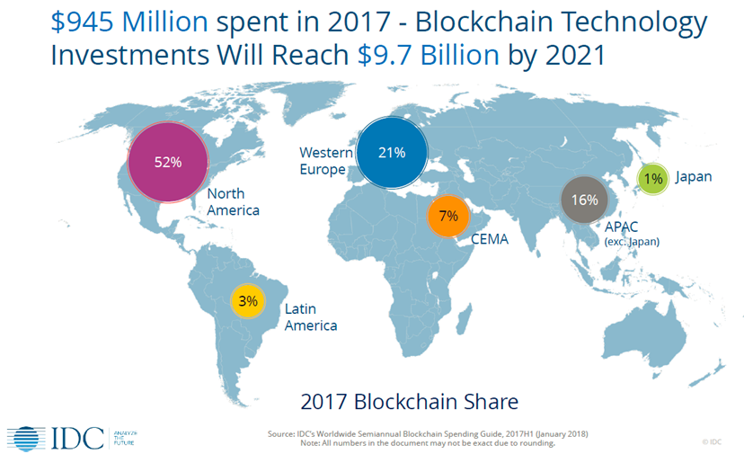

Blockchain Momentum
2x: Growth in projected spend from 2018 to 2018
3x: The number of blockchain-related LinkedIn job postings more than tripled over the last 12 months
22%: of industry CIOs are in a planning stage or experimenting with blockchain, and another 43% have it on their radar

Slide 11

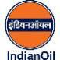




Sample Customer Use Cases Across Industries
LOGISTICS
CORP. FINANCE & FINANCIAL SERVICES
Maritime shipping documentation
Bank Guarantee
PROJECT MANAGEMENT
GLOBAL TRADE
Solar Energy Project Tracking & Rewards Solution
Excise Licensing and Taxes
E-COMMERCE
SUPPLY CHAIN
Multi-brand loyalty network
Food Provenance & Quality Tracking
Notes:
Market and Markets
Anytime you want a secure -- but potentially shareable -- record of a transaction, blockchain can be a fit.
There are use cases in retail and e-commerce. Logistics. Finance. Healthcare. Energy. The list goes on and on.
There are those that believe that blockchain could revolutionize the way business is done. Gartner, for example, estimates that blockchain could create $176 billion dollars of value-add by 2025. How? Cost savings, accelerated processes and increased business output.

Slide 12
Challenges for Blockchain in the Enterprise
Complex to Setup
Difficult to setup open source software, along with required security, & infra. dependencies
Integration Challenges
Expensive & complex to Integrate diverse data sources with enterprise business applications
Requires
Enterprise-grade Capabilities
Blockchain requires enterprise-grade resilience, scalability, security, and performance
Keeping up with Open-Source Evolution
Open source software such as Hyperledger innovates rapidly, keeping platform up to date is challenging
Operational Challenges
Disaster recovery, backups, restores, patching, monitoring can get expensive for ops
To address these challenges enterprise need an Integrated Platform

Slide 13
Oracle Blockchain Strategy
Securely, reliably extend business processes and accelerate B2B transactions
PRE-ASSEMBLED, ENTERPRISE-GRADE MANAGED PAAS
Rapid, global provisioning & simplified operations
Secure and confidential permissioned blockchain
Built-in monitoring, IdM, HA, autonomous recovery
EXTENDS ENTERPRISE BOUNDARIES
Plug-n-Play integration with Oracle SaaS and PaaS, and custom/3rd party cloud and on premises apps
Out-of-the-box API access in Netsuite ERP, Flexcube core banking, Open Banking API Platform
SAAS BLOCKCHAIN APPLICATIONS
Supply chain track & trace use cases and more
SMART CONTRACTS
PRIVACY
CONSENSUS
DISTRIBUTED LEDGER
13

Slide 14
Oracle Blockchain Cloud Platform
ORACLE SAAS
ON PREMISES APPS
3rd Party SaaS
Custom Cloud Apps
External Members
CRM
ERP
HCM
CX
SCM
REST API / SDKs for Go, Java, and Javascript
SMART CONTRACTS
Business logic based on agreements
CONFIDENTIALITY
Permissioned blockchain with private channels
DISTRIBUTED LEDGER
Whole state data and its history
CONSENSUS
Validates transactions before adding to chain
Hyperledger Fabric Peers in Customer Datacenters or 3rd Party Clouds
ORACLE BLOCKCHAIN PLATFORM
OPEN SOURCE HYPERLEDGER FABRIC
Container services
Identity Management Services
Events
Management Services
Data Services
ORACLE PAAS SERVICES
Managed PaaS
*
Oracle Public Cloud
Oracle Datacenters
Oracle Cloud@Customer
Customer Datacenters
ORACLE FLEXIBLE DEPLOYMENT OPTIONS
*Coming soon
14
Notes:
At the core it consists of Hyperledger Fabric, which is a foundational building block for Oracle Autonomous Blockchain Cloud Platform. It is an open-source software developed by Linux Foundation that provides the core blockchain capabilities of Smart Contracts, Consensus, Privacy, and Distributed Ledger.
Data Services provides connectivity to various storage services – Object storage, Kafka, and others (in future).

Slide 15
Oracle Blockchain Cloud Platform in Action
Peer Nodes
Distributed Ledger
(Single Version of Truth)
Applications
(REST API)
Smart Contract (aka Chaincode)
REST proxy
Membership Service
Ordering Service
Membership Service
Applications
(SDK based)
Ordering Service
REST Proxy
Admin UI
Admin UI
Applications
Managed PaaS
Notes:
From an enterprise perspective, we are looking at permission blockchain here we need someone to authorize someone to identify. Everyone has to be identified to show who is participating on the blockchain and what transactions they are executing.
<Click1>
So, first component of course are the peer nodes. Nodes represent an organization. Blockchain is basically a business network that you are creating and there are multiple organizations participating in that. You can't have just one node in the blockchain network there have to be multiple nodes and these nodes are talking to each other over the network. It could be over the internet could be something else. So these are the nodes which are representing organization doing most of the work.
<Click2>
Of course the blockchain is a distributed ledger technology there has to be a ledger with each of the nodes. Each node maintains its own ledger -- that's where all the transaction information is stored.
<Click3>
How this information is stored is through a smart contract. A smart contract is the piece of business logic that is executed on these nodes and it looks at the world state and based on that it updates the ledger.
<Click4>
Ordering service is the centralized point of trust in a decentralized network. Ordering service helps to construct and maintain ledgers as a totally ordered hashchain of blocks of transactions that provides a verifiable history of state changes.
<Click5>
This is a permission block chain. For permission blockchain there has to be some sort of membership services and entity services which can say only these people are authorized to participate in this blockchain network. Not anyone can do a transaction -- anonymity is a feature of Bitcoin that's how Bitcoin came up because you don't want to be identified when you are doing transaction over the Bitcoin which you can be anonymous. But on this permission blockchain you have to be identified that's and there has to be a membership service there.
<Click6>
In our service we have a REST proxy to serve up APIs from the platform for applications. Using REST APIs reduces the programming complexity considerably compared to using Hyperledger Fabric SDKs directly.
<Click7>
Then if we have so many components you need some sort of admin console – some sort of monitoring tool that using which you can monitor your network. You update your network to the administration tasks
and so on so there has to be an administration console.
<Click8>
Last but not least, you have to have the end-user applications which are talking into the blockchain network so these applications can use that various API is to invoke the smart contract which will start a transaction on the blockchain network.
This is what a blockchain network component would look like in any platform.
<Click9>
All these capabilities are offered as a fully managed PaaS Cloud Service that is managed by Oracle.

Slide 16
Value Proposition Oracle Autonomous Blockchain Cloud Service
ORACLE AUTONOMOUS BLOCKCHAIN CLOUD SERVICE
Oracle’s
Experience and Expertise
Pre-Assembled
Open
Plug and Play Integrations
Enterprise-Grade
Autonomous
Notes:
Pre-assembled - Auto-provisioned HLF components, REST proxy and ops. console with built-in identity management, object store and other infrastructure, reducing cost & setup time from weeks to minutes
Open - Built on Hyperledger Fabric, an open-source project governed by Linux foundation, interoperable with non-Oracle versions accessible from cloud and on-premises applications via Rest APIs and Fabric SDKs
Plug and play integrations - with Oracle and 3rd party apps for faster integration with diverse systems of record, improving time to market by months
Enterprise-grade - The only enterprise-grade managed service with 99.95% SLA with enhanced security, built-in HA and continuous ledger backups for multi-datacenter DR
Autonomous - Industry’s 1st & only autonomous blockchain cloud platform to simplify operations and enable customers to focus on applications with Oracle managed service lifecycle & automated recovery
Expertise and Experience - Working with customers in many industries to implement blockchain solutions leveraging our decades of industry experience & partner ecosystem trained on Oracle blockchain

Slide 17


Reduce Cost & Accelerate Business
Integrated invoice factoring marketplace with Oracle EBS’s across multiple LOBs
Sped-up transactions & eliminated transfer fees of banks & intermediaries
Notes:
GE needed to optimize the flow of information across engineering, supply chain, manufacturing, and services to connect machines, intelligence, and people.
They selected Oracle ERP Cloud to consolidate 200 ERPs to 40 to automate business processes and to accelerate insight.
They also selected Oracle Integration Cloud as the integration platform to automate over 100 ERP integrations in less than 40 weeks.
That is half of the development time that as on-premises and at less cost and risk.
GE plans to move 70% of the software it runs in house today to the cloud by 2020

Slide 18

Accelerate Business Process
A better system to track, tokenize & automate solar rewards using Oracle Blockchain
10x increase in the velocity of Solar SiteDesign’s “lead to cash” ERP process
Notes:
(with Oracle NetSuite)
Watch On-demand webinar: http://www.netsuite.com/portal/email/Webinar_Horiz_BlockchainPt4OnDemand_EM_0518_Blog.html
While most businesses are still mulling over the implications of blockchain, some, like NetSuite customer Solar Site Design, are diving in head first. Needing a distributed ledger (blockchain) to help them achieve scale, SSD co-founded the Energy Blockchain Network (EBN) in 2017, building on NetSuite and Oracle Blockchain Cloud Solutions. Join this webinar for exclusive insights with the CEO of Solar Site Design, Jason Loyet and Co-founder of EBN, Nathaniel Enders on how they successfully developed and implemented a blockchain solution for their business. During this session, you’ll see a high-level demo of their use case and learn tips for your own exploration
Business Need: A better system to track, tokenize and automate solar rewards
Solution Implemented: Blockchain solution that can track who in the network gets rewarded Solution: Oracle Blockchain integrated with SSD’s Netsuite installation and custom application
Results: Order of magnitude increase in the velocity of their “lead to cash” ERP process with Oracle Blockchain solution

Slide 19
Business Benefits of Oracle Blockchain Platform
Drive Innovation
Enable new business models and revenue streams
Transform your business networks by rapidly on-boarding network participants
Improve traceability and visibility across your ecosystem
Accelerate Business
Rapidly automate multiparty business processes
Quickly scale business globally across the value chain
Speed up existing business processes through Oracle blockchain integration accelerators
Reduce Cost & Risk
Reduce Cost by eliminating unnecessary intermediaries, paperwork, and delays
Reduce Risk from single point of failure and insider attacks by using hybrid blockchain network
Reduce risk from human error and manual processes with consensus based, immutable audit trails
Notes:
Drive Innovation
Enable new business models and revenue streams by securely extending your business processes and rapidly experimenting on Oracle’s preassembled blockchain platform
Transform your business networks by rapidly on-boarding network participants on the Oracle’s enterprise-grade blockchain platform and securely automating consensus
Improve traceability and visibility across your ecosystem through Oracle’s plug-and-play integration adapters and increased developer productivity
Accelerate Business
Rapidly automate multiparty business processes to quickly and efficiently drive new business through plug and play integration across diverse systems of record
Quickly scale business globally across the value chain by onboarding participants across the globe on autonomous blockchain platform using Oracle’s cloud data centers
Speed up existing business processes through Oracle blockchain integration accelerators for oracle SaaS and on premise applications
Reduce Cost & Risk
Reduce Cost by eliminating unnecessary intermediaries, paperwork, and delays with a trusted, production-ready Oracle blockchain platform for peer-to-peer business transactions
Reduce Risk from single point of failure and insider attacks by using hybrid blockchain network built on Oracle’s enterprise-grade platform in global Oracle cloud infrastructure integrating with third-party clouds
Reduce risk from human error and manual processes with consensus based, immutable audit trails by using Oracle’s process and integration tools to easily maintain single source of truth across the ecosystem

Slide 20

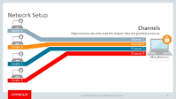

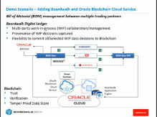
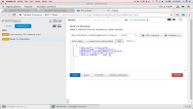
Applications Built with Oracle Autonomous Blockchain
Click screenshots to play
Demo 1 (8:33) Tracking auto parts in a car dealer network, each with its own Oracle Enterprise Resource Planning and Blockchain Cloud Service integration
Demo 2 (8:33) Multi-party contract manufacturing application with data from Oracle Enterprise Resource Planning and Supply Chain Management
Demo 3 (4:33) Developing a smart contract (automatically executed blockchain transaction)
20

Slide 21
Next Steps
Next Steps
Learn More
cloud.oracle.com/blockchain
Try for Free Today
cloud.oracle.com/tryit
Get Updates & Contact Us to Discuss Use Cases
oracle.com/blockchain

Slide 23
Region: EMEA

Slide 24
Track Supply Chain
System to certify the supply chain of the olive oil producer, through the phases of production, packaging and shipment
Increases quality control, ensures only authorized sellers & buyers, and ensures a more credible reputation for the company
Notes:
Certified Origins is brand management company who commercializes different extra virgin olive oil from fruit grown the family farms.
Use Case - Blockchain will be implemented in order to certificate the supply chain of the oil producer, through the phases of production, packaging and shipment
Product Provenance Tracking
Production quality & ingredients testing visibility
Product journey tracking (temperature, etc.)
Change of ownership and custody verification
Paperless logistics
Benefits: Tracking, Transparency, Improved Trust and Cost Savings
Seller Benefits:
Authorised marketplace
Trusted transactions
Auditable sales
Increased revenue
Quality Compliance Benefits:
No Illegal trading
Only Authorized sellers & buyers
Traceable records
Visibility and security throughout Supply Chain
Buyer Benefits:
Traceability of source
Fraud free transactions
No recalls
No bad quality supply
Credible reputation
------------------------
First EMEA Blockchain Win, prior to GA
$20K ARR Universal Credits, just above minimal deal size (based on EMEA budget estimator)
Team: Francesco Palanza (OD Rep), Andrea di Placido (OD SC),Filippo Cutillo (EMEA Cloud Pursuit), SCC Team
SCC started with prototype, Go live expected October 1

Slide 25


Innovate & Grow Revenue
Used blockchain to easily identify counterfeit goods, fraudulent licenses
Quickly and easily process claims and determine duty owed with blockchain
35% reduction in processing time, and enhanced collection of duties
25
Notes:
(With Blockchain Asset Management & Dataflex)
6 different groups (a.o. NCS, Banks, Food and Drug Administration and Control, Standards organization) will participate in platform solution with analytics and integration to existing data sources. Delivered by partner BC Asset Management
Need: Protect revenue by identifying fraudulent & counterfeit goods, licenses and approvals, & determine duties owed
Solution: Use Blockchain to enable transparency & distributed single source of truth among 6 organizations
Product(s): Oracle Autonomous Blockchain Cloud Service; Other PaaS: OIC, DBCS, Analytics CS, CECS & IDCS Fusion Financials
Results:
Enhanced collections of fees, duties and levies 35% reduction in processing time, assurance of compliance Compliance with government legislative and regulatory requirements

Slide 26
Region: APAC

Slide 27

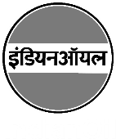
Reduce Counterfeit Transactions
Convert current bank guarantee process to electronic instead of manual, paper-based to reduce discrepancies due to errors/fraud
Reduce counterfeit bank guarantees which saves money
Speed processing times and provide a process for tracking across all parties involved
27
Notes:
Blockchain manages ICOL’s Bank Guarantee
Background: Current Bank Guarantee (BG) process is totally paper based, which this is a critical path for Oil & Gas industry across 3 parties:
Customer (Multiple entities from Oil & Gas releases tenders)
Vendors (Multiple vendos apply for various tenders)
Banks (Multiple public-sector Banks can create BG)
Pain: Discrepancies due to errors/frauds are often found after the hard copies are processed, where corrections (invoke, amend or return) takes time and it becomes pressing issues around BG expiries.
Solution: Blockchain acts as an immutable record of every transactions which maintained in the Public Ledger of each party using Oracle Blockchain Cloud Service (OBCS). An Oracle JET Dashboard application deployed on Oracle Application Container Cloud Services (ACCS) that provides an unique view of the stakeholders in the process. End-to-end BG process are tracked using Oracle Process Cloud Service (PCS). Digitization of the BG early in the process using Oracle Content and Experience Cloud Service (CECS).
Benefits:
Reduction of loss from counterfeit BG.
Shorter lead time of cycles from Vendor to Client.
Introduction of a non-repudiation process with provenance and trackability for fast resolution of any conflicts.

Slide 28

Enhanced Consumer Loyalty
Launched an “Integrated Mileage Platform” supporting the conversion of transportation mileages into commercial loyalty points
Improved customer experience, increased consumer loyalty and expanded customer base
Notes:
M2O Korea (Subsidy of Xioix Planet)
Blockchain as Integrated Platform for Travel & Transportation Mileage
Business Need: Plan to launch “Integrated Mileage Platform” supporting the conversion of transportation mileages into commercial loyalty points . Keep consumer loyalty and expand the reach to broader community within the participants.
Solution: With Blockchain, all participants simultaneously manage identical transaction data for mileage status, mileage history per customer without additional reconciliation
Oracle Product(s): Oracle Autonomous Blockchain Cloud Service, Oracle Autonomous Mobile Cloud, and Oracle Integration Cloud.
Results: Building up the loyalty exchange platform among airlines and e-commerce services. Services to improve customer experience, enhance loyalty and broader customer spectrums.
Background: Xioix Planet(http://xioixplanet.com/?ckattempt=2) is a specialized AR / VR developer and attained a market leader position in Korea. The group founded M2O recently, with an objective to build an integrated mileage platform transforming transportation mileages into a new opportunity.
Use Case: Plan to launch “Integrated Mileage Platform” supporting the conversion of transportation mileages into commercial loyalty points and providing ICO based business. With Blockchain, all participants simultaneously manage identical transaction data for mileage status, mileage history per customer without additional reconciliation. It covers:
Swap your transportation mileage for commercial loyalty points.
Transfer Debt to revenue for companies travel & transportation
For others as new business model to exchange loyalty programs
Architecture based on Blockchain CS, Database CS and Application Container CS, and SOA CS for the integration with the enterprise legacy systems.
Why Oracle: Values Oracle’s cloud-based technology that offers more fluidly than on-premise for better time-to-market in development, test, service launch. Plan to launch its service at the end of 2018

Slide 29


Increase Trust & Transparency
Visibility into the flow of documents, goods, and payments by using blockchain to provide a distributed single source of truth
Improved utilization by 50%
Improved bottom line by 5%
Notes:
Business Need:
Lack of transparency between cargo shippers, brokers, and carriers leads to loss of carrier revenue due to inefficient capacity utilization, delays due to manual, error-prone document sharing, “no show” by shippers, and increased transaction cost of brokers.
Solution Implemented:
Augment existing business relationships with trust and visibility into the flow of documents, goods, and payments by using blockchain to provide a distributed single source of truth.
Solution
Oracle Autonomous Blockchain Cloud Service integrated with their custom ERP and Supply Chain systems that run Oracle databases
Result (Just placeholders for now, numbers are made up)
Improved utilization by 50%, improved bottom line by 5% by reducing shipper “no show” and eliminating expensive processing fees, and orders of magnitude speed-up of business processes and payments by eliminating manual paper-laden processes.

Slide 30
Region: LAD

Slide 31
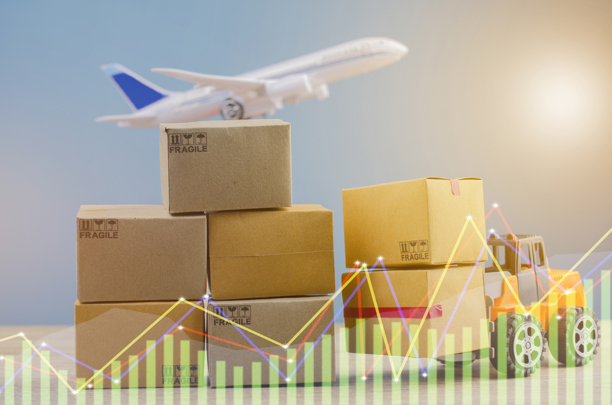

Reduce Fraud & Damages
Track and transfer ownership of e-Commerce packaging
Reduce high levels of fraud, theft and damages
Full visibility to logistics chain also allows for faster customer inquiry response
Notes:
Intelipost (LATAM, reducing fraud and damages)
Background: a Brazilian-based Transportation Management SaaS for logistics that allows e-commerce retailers to lower shipping costs, improve control, and achieve better delivery SLAs.
Challenge: Need to implement a more robust system for package tracking and transfer of ownership (over 3-4 trucking companies) to reduce high levels of fraud, theft, and damages.
Solution: Implementing Oracle Blockchain cloud service in conjunction with the largest retailers to enable full tracking and transfer of ownership of e-commerce packages as well as providing full visibility into logistics chain, which allows for faster customer inquiry response.
Results:
Insurers: reduced payouts due to fraud and theft.
Shippers: Higher customer satisfaction when shipper has full visibility and can respond to customer inquiries.

